Slide 1

Smart City / Civil and Construction Engineering
A.I. FOR ENGINEERING

Slide 2

A.I. Powered Detection of Roadside Asset Issues
Theme: Smart City / Civil and Construction Engineering
Key Objective:
Leverage AI to automate the detection of roadside asset issues, including damaged road signs and illegally dumped rubbish.
Enhance urban infrastructure maintenance through efficient and accurate deep learning models.
Why this is better: It's more concise and focuses on the power of AI to solve infrastructure problems, emphasizing both the "automation" and "urban infrastructure maintenance."

Slide 3
Meet Our Team
Team Members & Roles:
Rupayan Banerjee: Led data annotation and developed the user interface for interacting with the model.
Vivek Saini: Researched and tested pre-trained object detection models.
Tran Duc Anh Dang: Pre-processed the data and contributed to training the deep learning model.
Lochana Hettiarachchi: Fine-tuned the model and led evaluation efforts to improve accuracy.
Akindu Wikramarachchi: Focused on model testing and final performance analysis.

Slide 4

Why AI for Roadside Issues?
Motivations:
Manual monitoring is labor intensive and prone to delays.
AI enables rapid, automated detection, reducing costs and improving response times.
Contributes to smarter, cleaner cities with fewer environmental hazards.
Real-World Applications:
Urban Infrastructure Management: Automate the detection of road sign damage and illegal dumping to streamline maintenance.
Environmental Monitoring: Quickly identify and address environmental issues, enhancing public safety and cleanliness.
Smart City Integration: Enable real-time, automated asset monitoring to optimize resource allocation for city councils.

Slide 5
Dataset Overview
Dataset Source:
Rubbish Dataset: This dataset contains roadside images with illegally dumped rubbish.
Annotations: We used bounding boxes to label the location of rubbish and identified at least 10 familiar objects within the rubbish, such as mattresses, furniture, toys, and electrical goods.
Tools Used: LabelMe was used for annotations, and we converted the data into COCO format using labelme2coco for object detection compatibility.

Slide 6
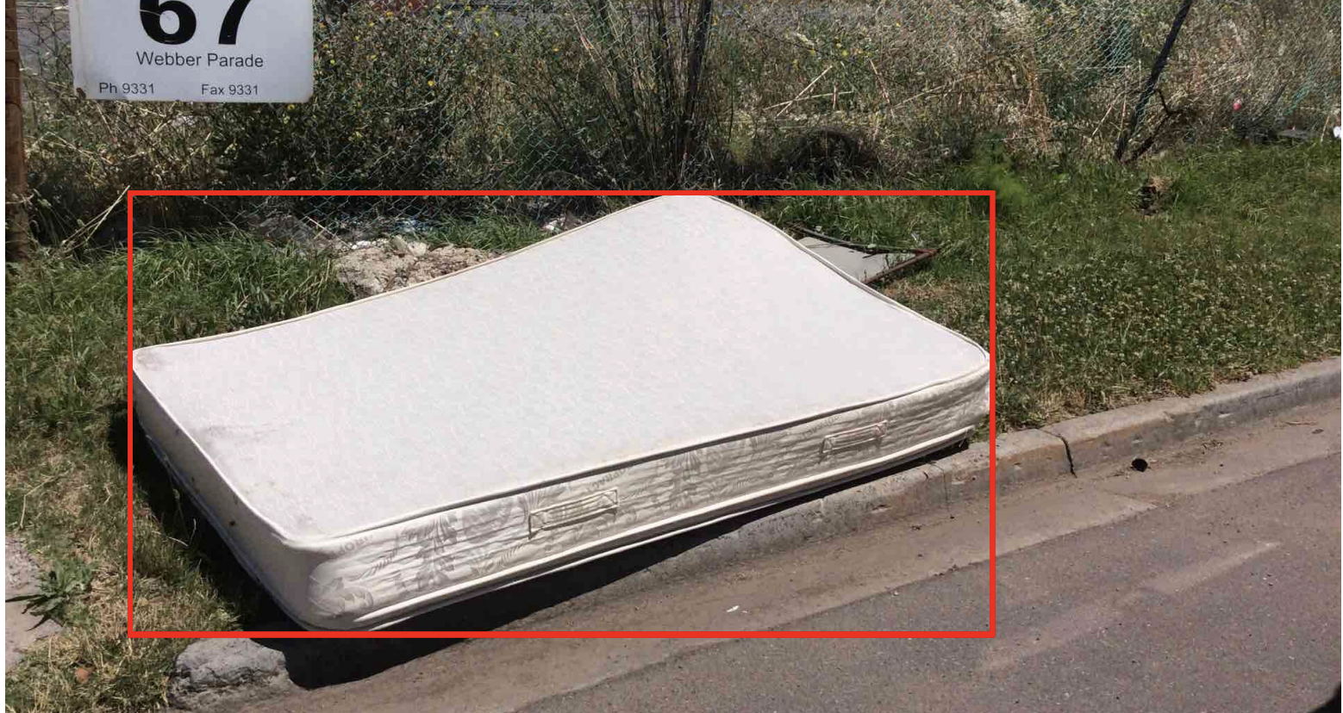
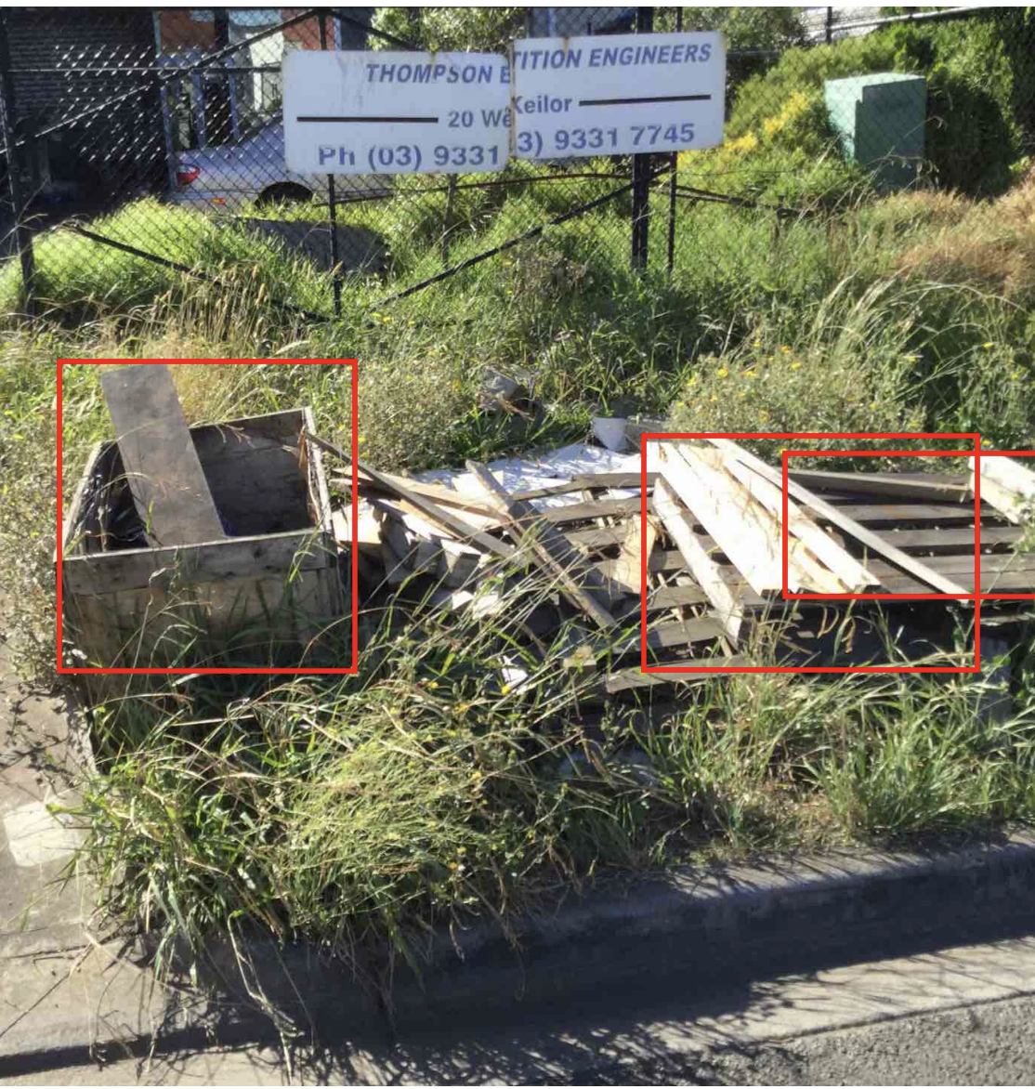
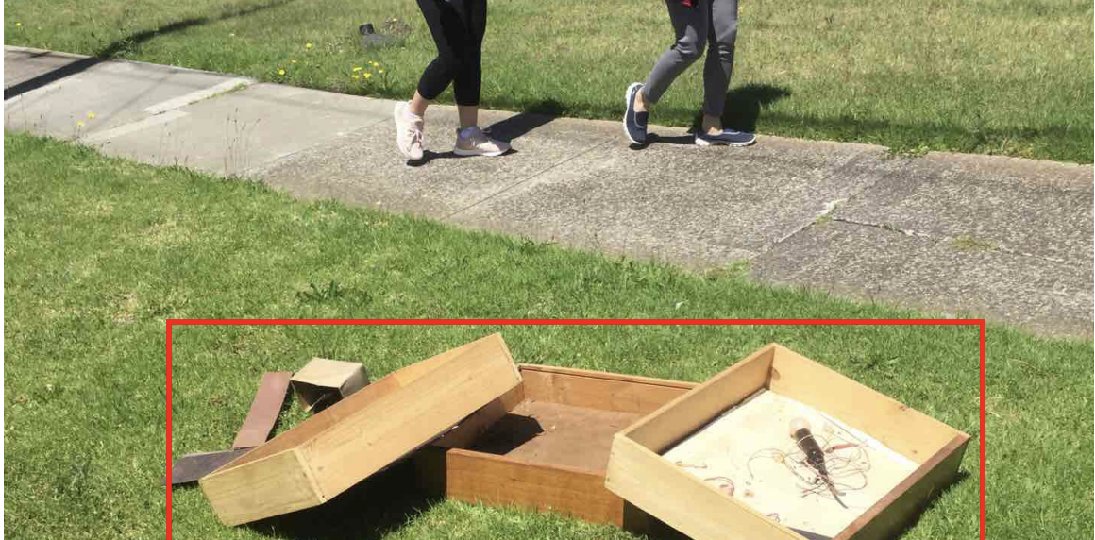

Slide 7
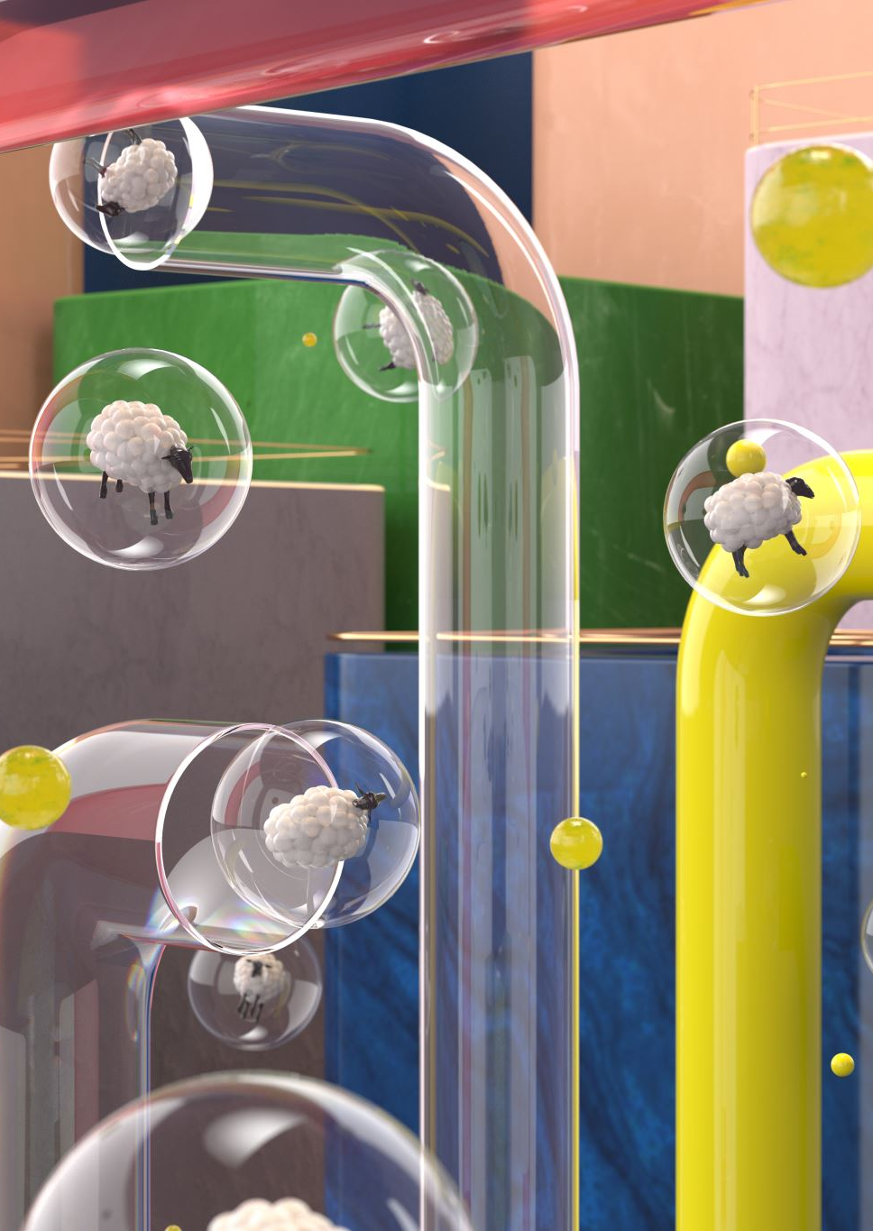
Workflow & Architecture
Project Workflow
Data Collection & Annotation: Focused on the rubbish dataset, where images were labelled with bounding boxes to identify rubbish objects (e.g., mattresses, couches, toys).
Data Preprocessing: Images were resized, normalized, and augmented to prepare the dataset for model training.
Next Step: Model Training: We plan to train the model using YOLOv8 on the annotated rubbish dataset. The model will be fine-tuned to detect dumped rubbish and classify familiar objects based on the labelled data.
Expected Output: The model will output detected objects and issues with confidence scores, helping identify illegally dumped rubbish and its components.

Slide 8
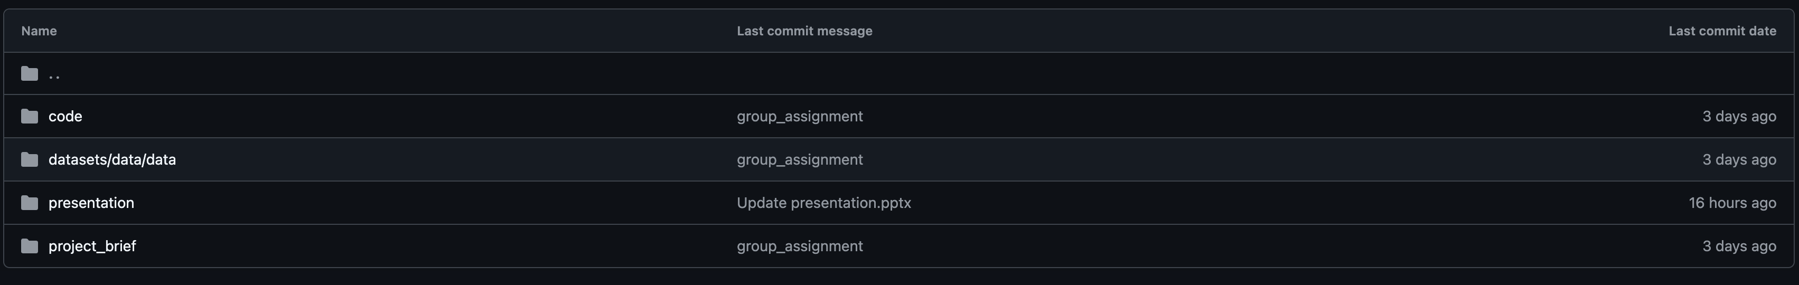
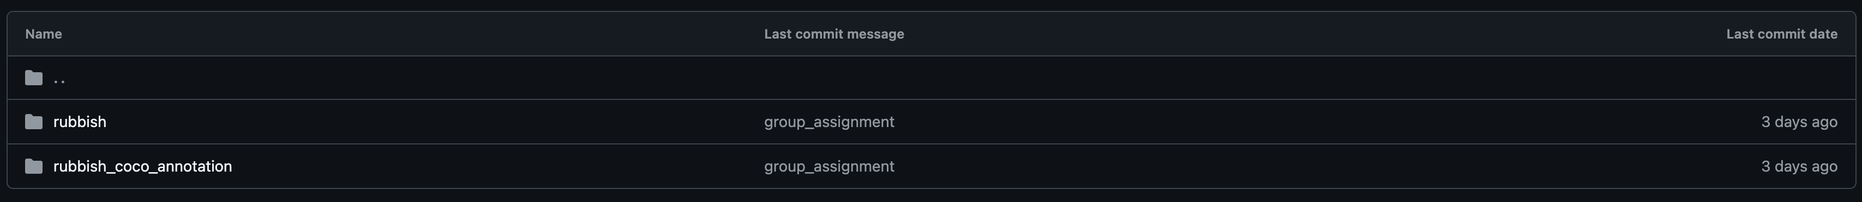

Slide 9
Model Performance & Insights
Model Chosen:
YOLOv8: Selected for its speed and accuracy in detecting multiple objects within a single image.
Optimized for real-time object detection, making it ideal for handling complex roadside scenes with various types of rubbish.
Expected Performance:
We expect the model to accurately identify both the location and types of rubbish (e.g., mattresses, couches, toys) with high confidence scores.
The model will provide bounding boxes around detected objects, along with confidence levels indicating the likelihood of correct identification.
Next Steps & Evaluation:
Once the model is trained, we will evaluate it based on key metrics, including:
Accuracy: How well the model detects rubbish objects.
Precision & Recall: The balance between false positives and false negatives.
Confidence Scores: Providing reliable detection results.
Potential challenges include handling varying lighting conditions, object occlusion, and cluttered backgrounds.
Future Improvements:
Post-training, we plan to fine-tune the model to improve performance under different environmental conditions (e.g., lighting, weather).

Slide 10

Thank you!

